Slide 1
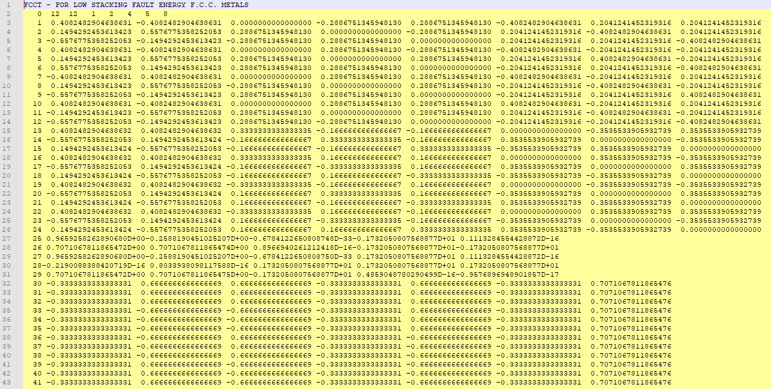
No of twin systems
fcct.pre
No of slip systems
Counter
Initial guess of 5 independent
deformation systems
TITglij
NGL NTW DI1 X Y
(A1)^{T}
each row is vector-formatted
symmetric part of Schmid tensor
(5 independent components);
all deformation systems, first slip systems, then twins
(B1)^{T}
each row is vector-formatted
anti-symmetric part of Schmid tensor
(3 independent components)
all deformation systems
(B)^{T}
inverse of the sub-matrix of A1
consisting of the initial guess deformation systems
(B2)^{T}
each row is matrix to calc. orientation of twin
G
twinning shear

Slide 2
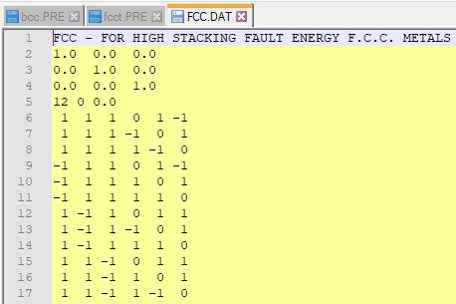
fcc.dat
description/title
unit cell
No. of slip systems
No. of twin systems
plane
Miller indices of deformation systems
(one system per row)
direction

Slide 3
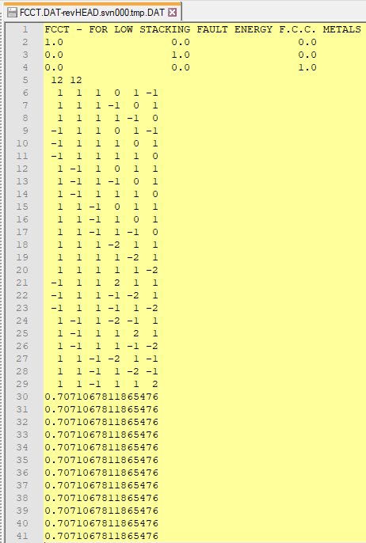
fcct.dat
description/title
unit cell
No. of slip systems
No. of twin systems
direction
plane
Miller indices of deformation systems
(one system per row);
slip systems first, then twin
G
twinning shear

